Slide 1
Contract Monthly Claim System
Presented by Xola Mgangxela
Prog6212
Part 3 final submission

Slide 2
POE
Part 1
Part 2
Part 3

Slide 3
POE Introduction
The CMCS is a C# .NET Core MVC application designed to automate the monthly claim process for contract-based lecturers.
The goal is to simplify claim submission, verification, approval, and HR processing.
Part 3 focuses on automation, workflow improvements, and final system enhancements

Slide 4
Overview of System Roles
The system includes three primary user roles:
Lecturer – Submits claims and uploads supporting documents
Coordinator/Manager – Verifies and approves/rejects claims
HR – Processes final claims and generates summaries/invoices
Each role now has a separate interface, based on Part 2 feedback.

Slide 5
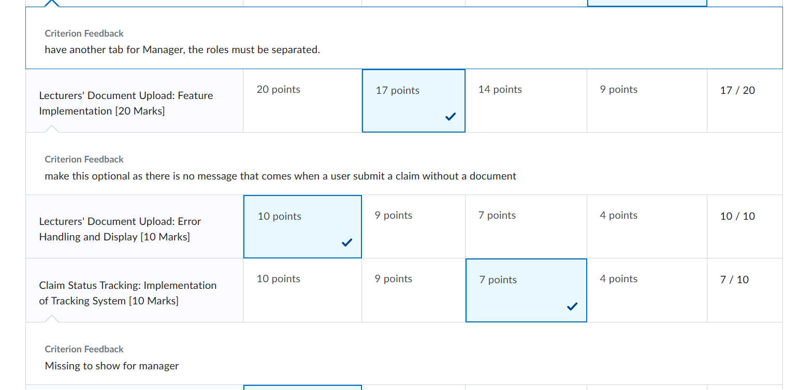
Summary of Part 2 Feedback
Lecturer recommended separating roles into different tabs/views. Suggested a dedicated Manager tab. Recommended improving navigation and UI clarity. I implemented all of this before starting Part 3

Slide 6
Part 3 Enhancements
For Part 3, I implemented:
Lecturer View Automation
Coordinator & Manager Workflow Automation
HR View Automation
Improved system accuracy and user experience
Automated calculations, rule-checking, and reporting

Slide 7
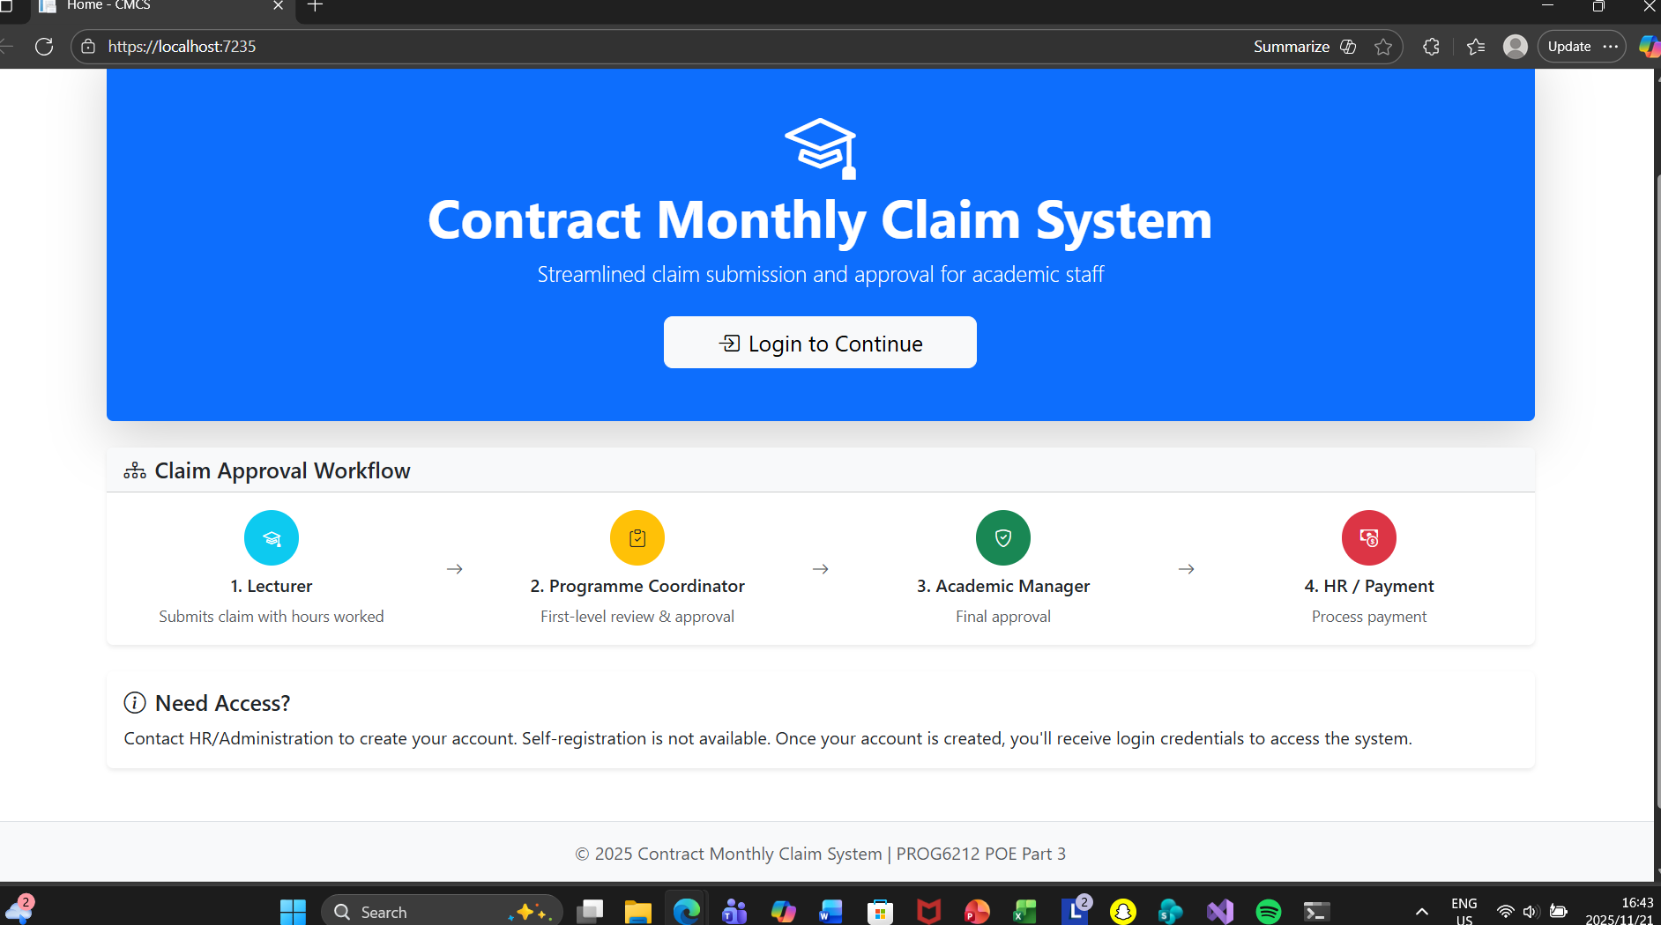
Screenshot

Slide 8
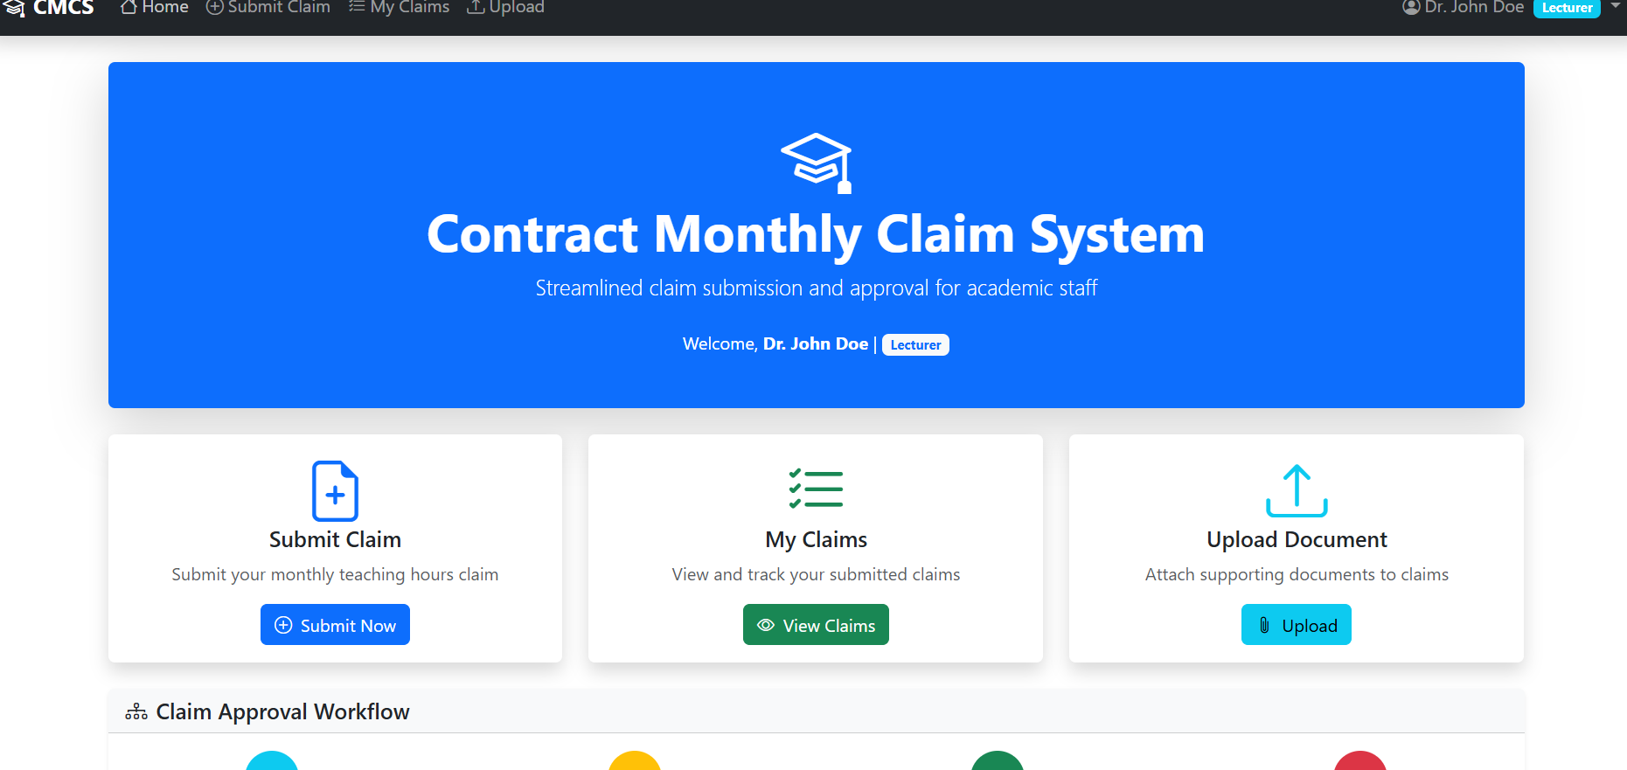
Lecturer View Automation
What I Implemented:
Automatic calculation of total payment: Hours × Rate
Prevents invalid or incomplete submissions
Improved user experience by showing instant feedback

Slide 9
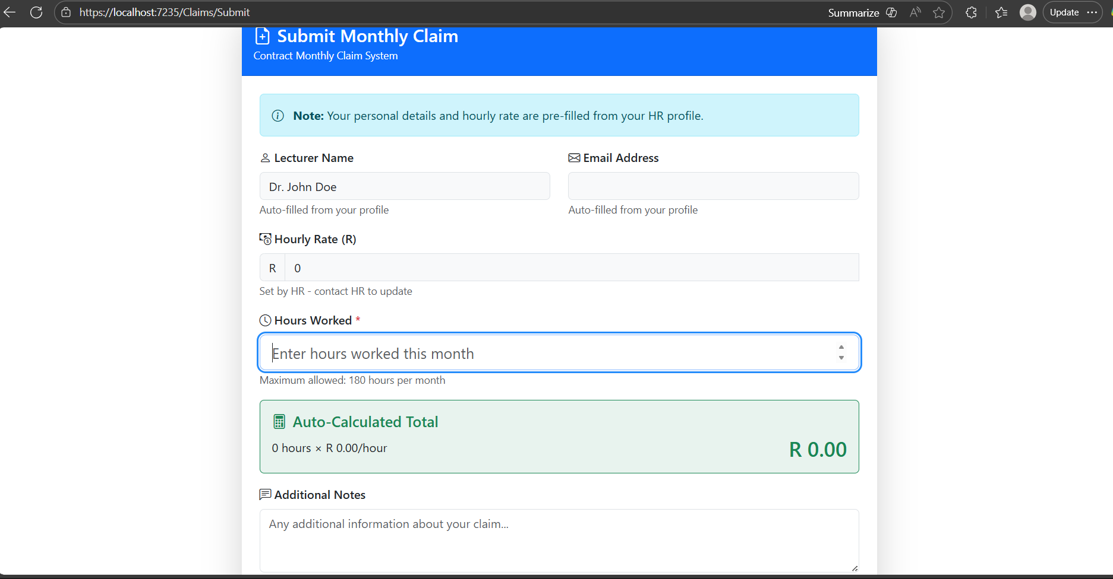
Screenshot

Slide 10
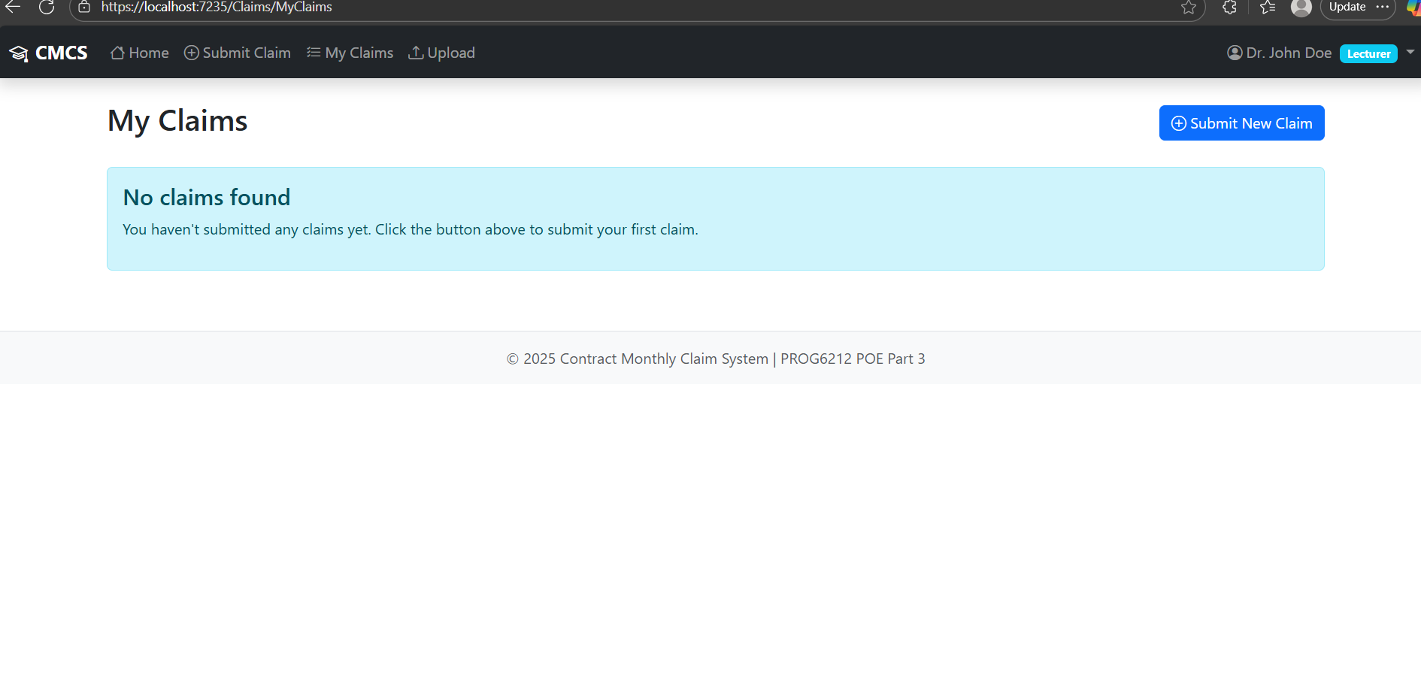
Screenshot

Slide 11
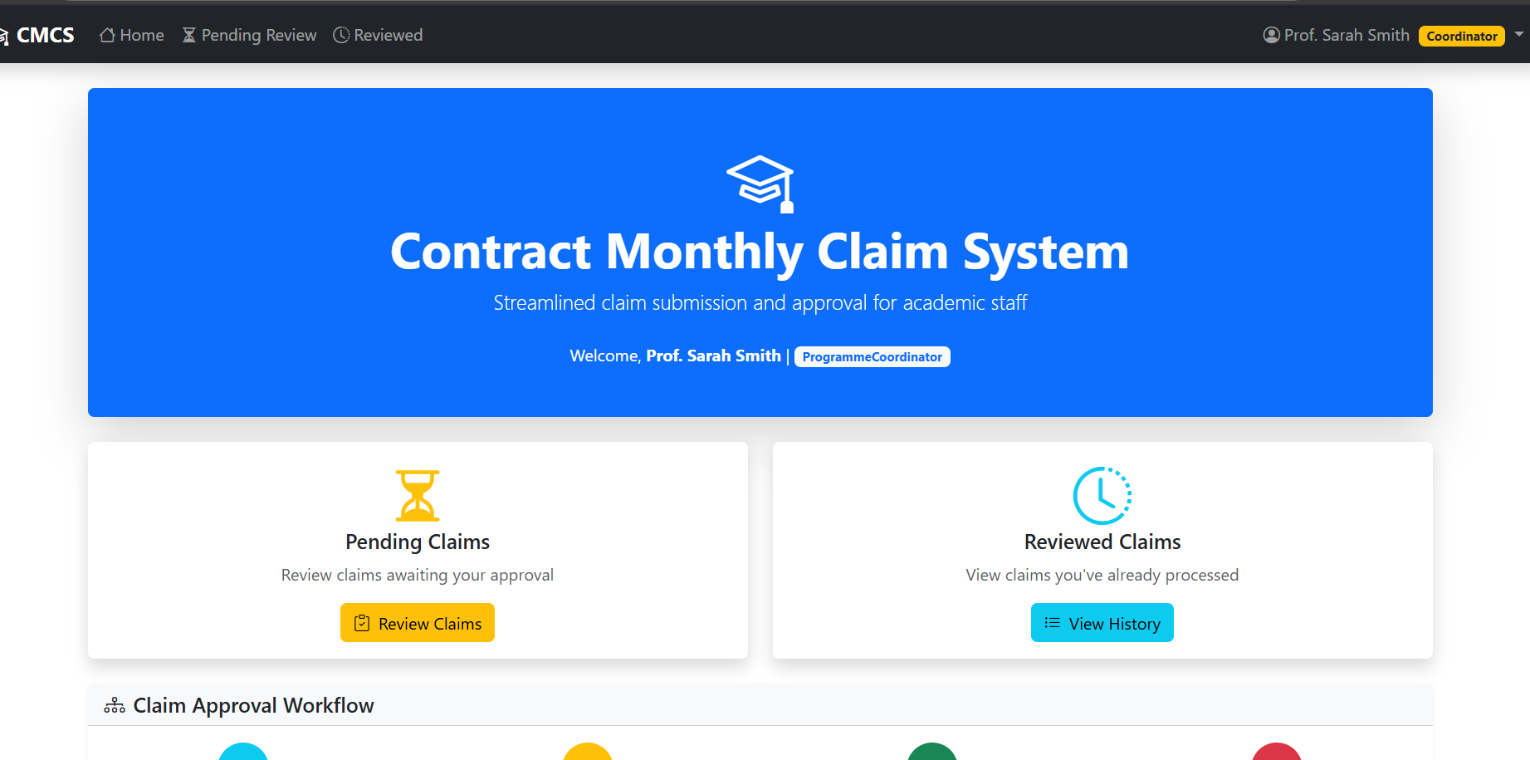
Coordinator and Manager Automation
Enhancements Added:
Automated verification logic (checking hours, rate, duplicates)
Approve/Reject buttons update claim status instantly
Used Entity Framework for real-time updates
Cleaner layout for reviewing pending claims

Slide 12
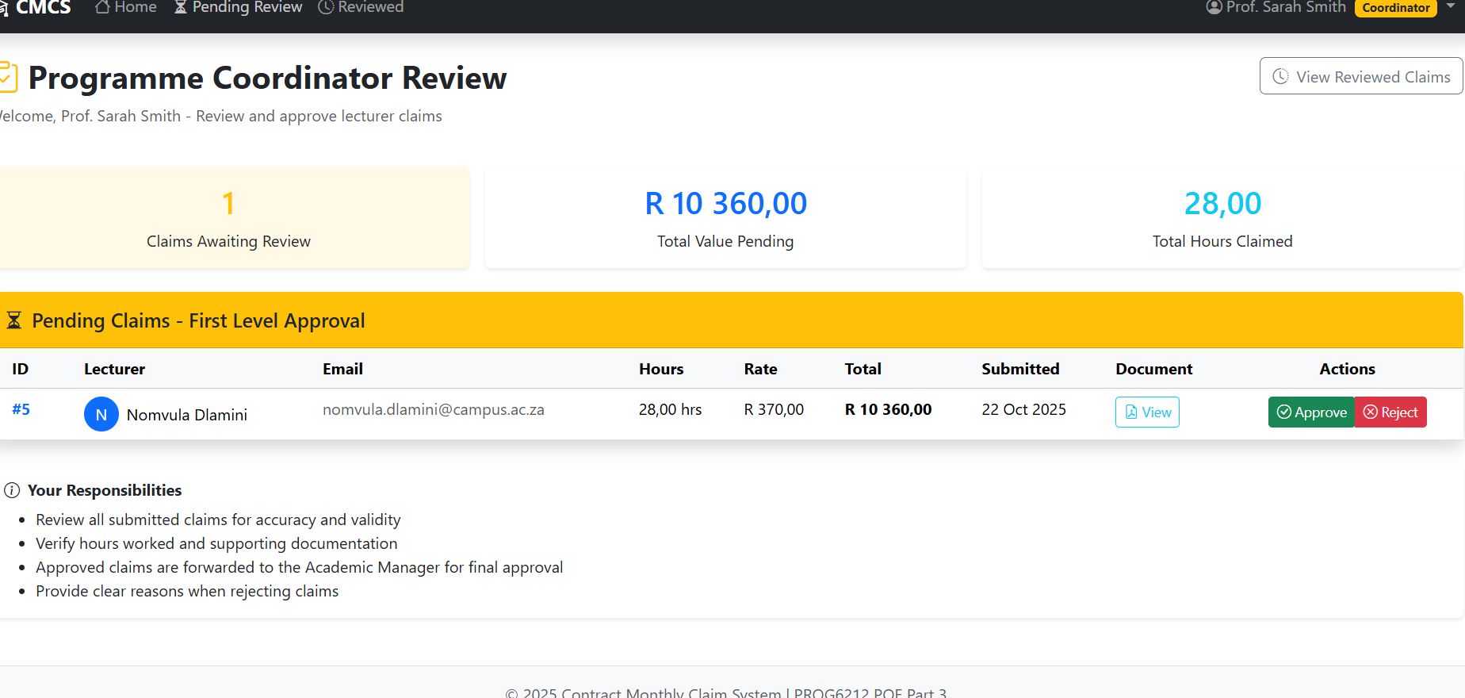
Screenshot (Coordinator)

Slide 13
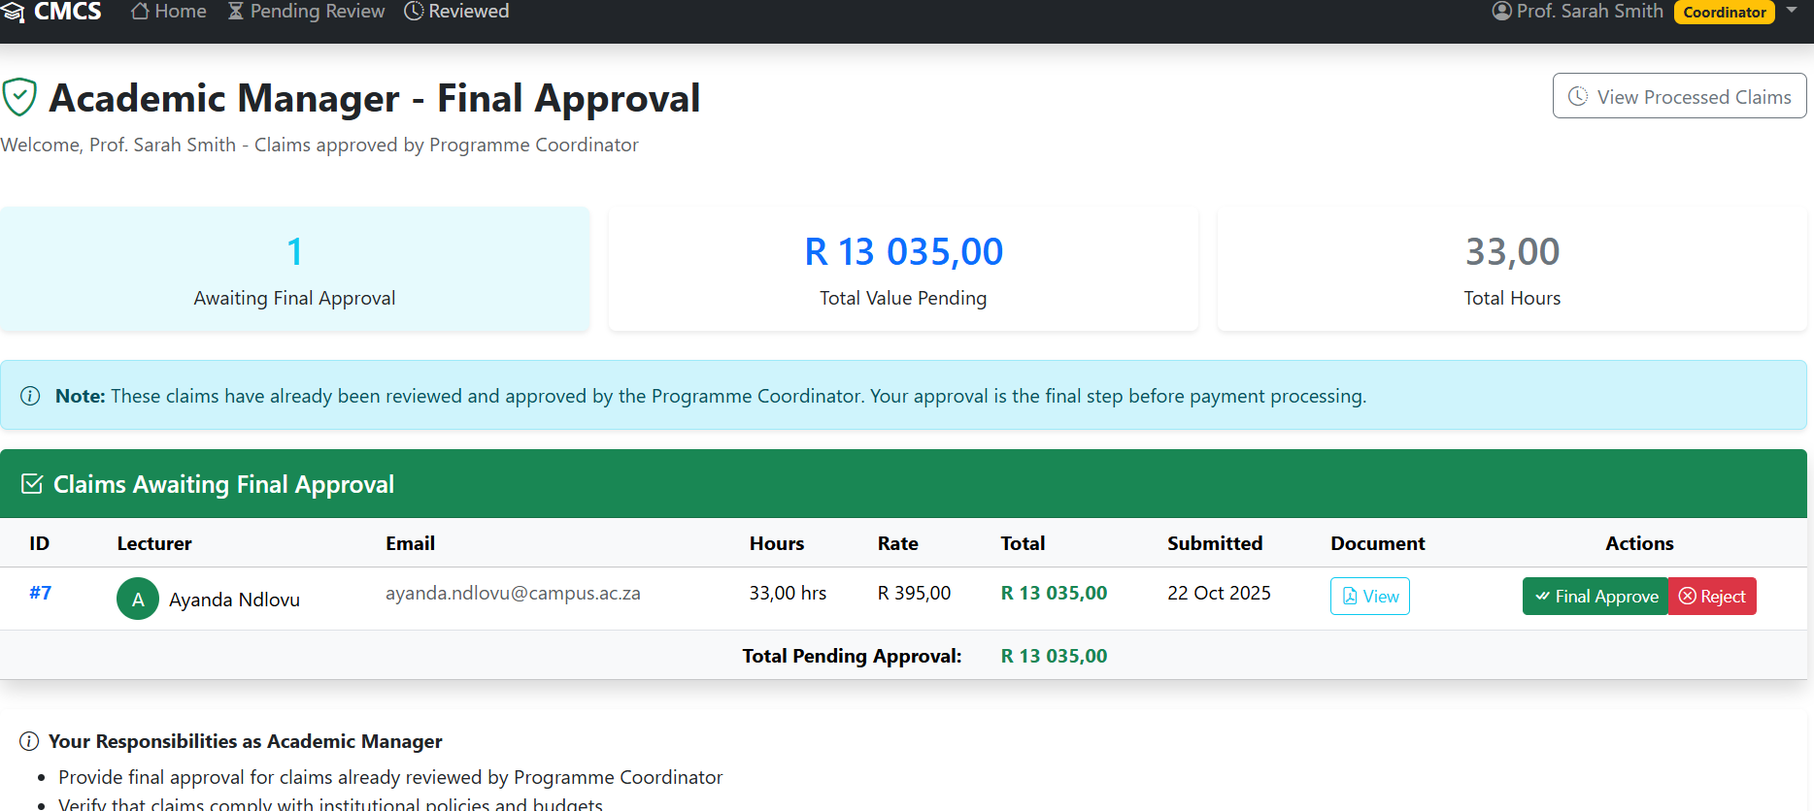
Screenshot

Slide 14
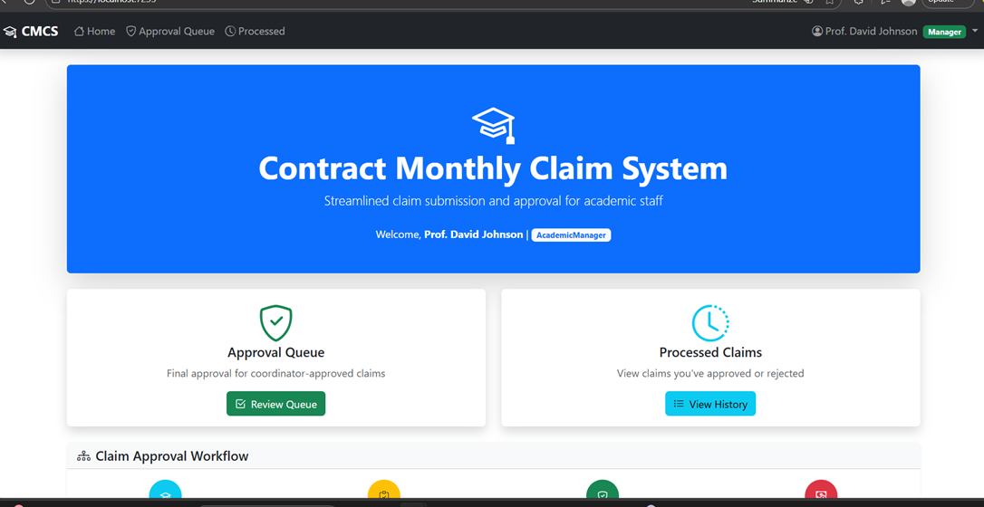
Screenshot (Manager)

Slide 15
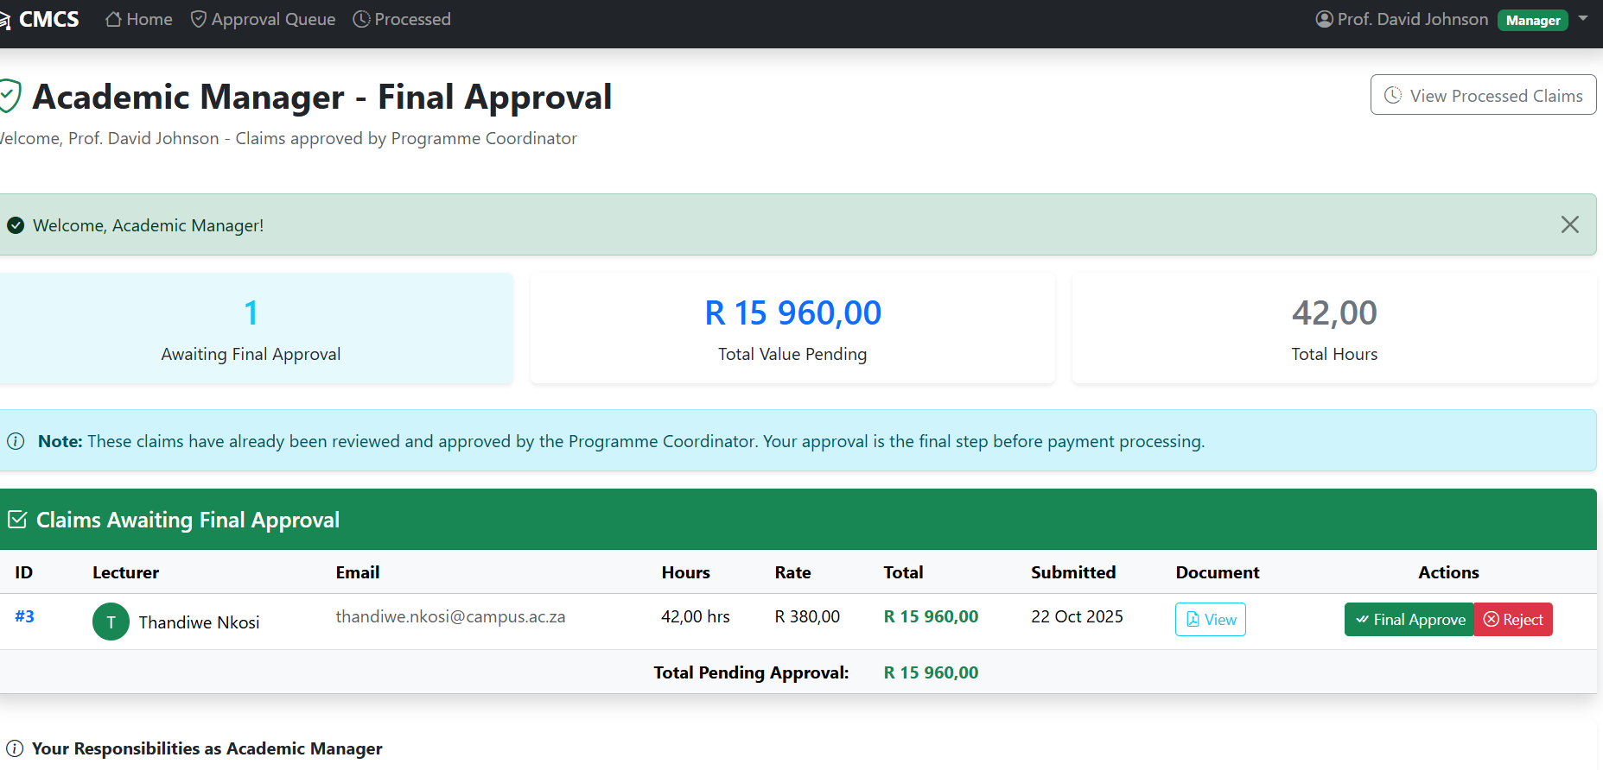
Screenshot

Slide 16
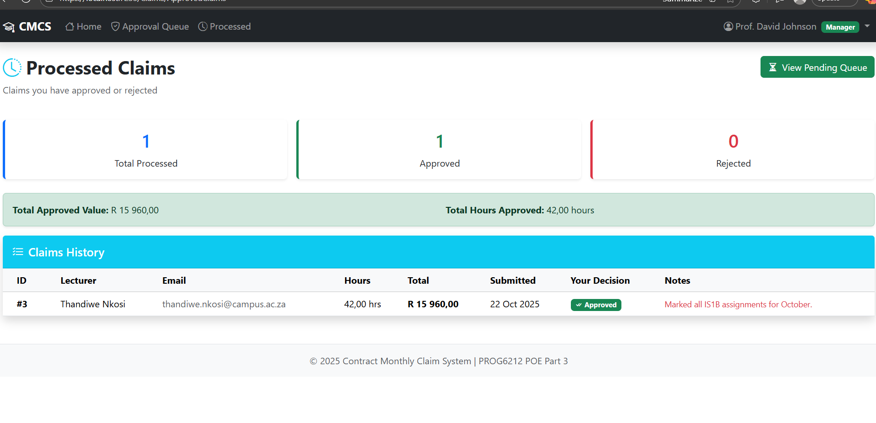
Screenshot

Slide 17
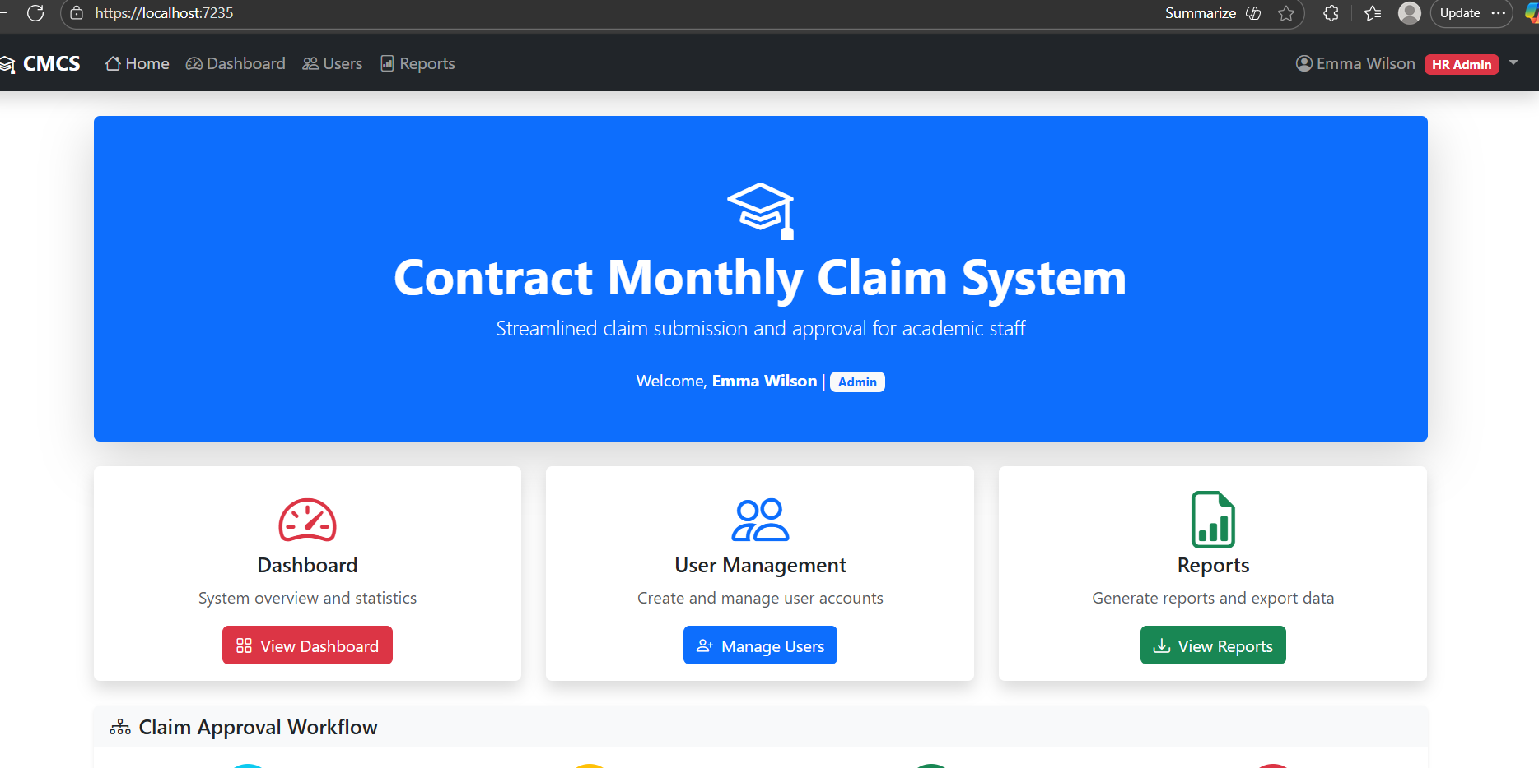
HR View Automation
New Features:
Automatically generates a report/summary of approved claims
HR can view lecturer details, approved totals, and pending payments
Reduces manual work and ensures higher accuracy

Slide 18
Claim Processing Workflow
Automated Workflow:
Lecturer submits claim
System calculates total automatically
Coordinator verifies
Manager approves/rejects
HR processes approved claims
Reports generated automatically

Slide 19
Thank you
st10439697

